Slide 1
API Testing
Using Postman

Slide 2
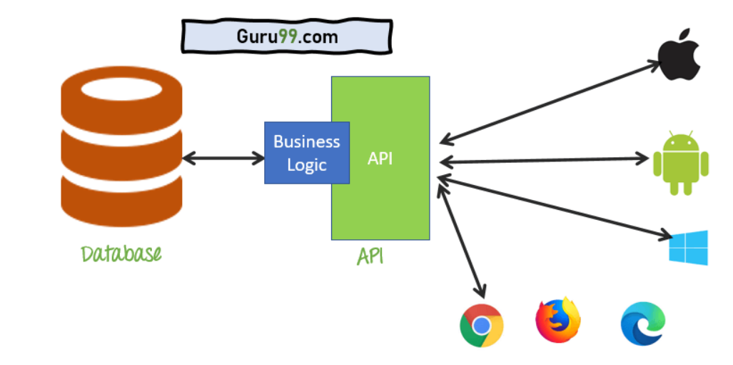
What Is API?
API is a software interface that allows two applications to interact, communicate and exchange data.
API Examples:
Restaurant – Waiter.
Google Maps APIs Embed Google Maps on webpages.

Slide 3
Output Of API Could be
Any Type Of Data like the number of available rooms.
Status (Pass/Fail)
Call Another API Function like Available Rooms API Calling Date To be Available API Function.

Slide 4
What is API Testing?
API Testing is a software testing type that validates Application Programming Interfaces (APIs).
The purpose of API Testing is to check the functionality, performance, and security of the programming interfaces.
We will Use Postman To Check The Functionality Of APIs.

Slide 5
What is Postman and How To install?
What is Postman?
Postman is a tool that allows us to work easily with APIs.
Postman is used for building HTTP requests that we send to the server running the API.
How To install it?
From The Website https://www.postman.com/downloads/
There are two ways to run Postman:
As a standalone app.
Directly in the browser.
Notes:
Move ordinal

Slide 6
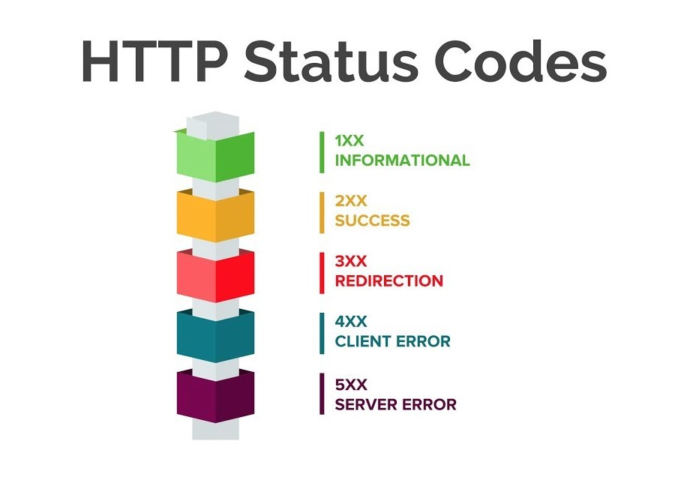
Your First Request With Postman.
All APIs Should use HTTPS ‘Secure Hypertext Transfer Protocol’ but it may use HTTP Protocol it is a security matter.
HTTP Request Message will contain :
URL
Headers (User-Agent: Postman)
Request method(Post-Get-Put-Delete)
Body
The HTTP response message will contain:
Status (200,401,500,…..)
Headers
Body

Slide 7
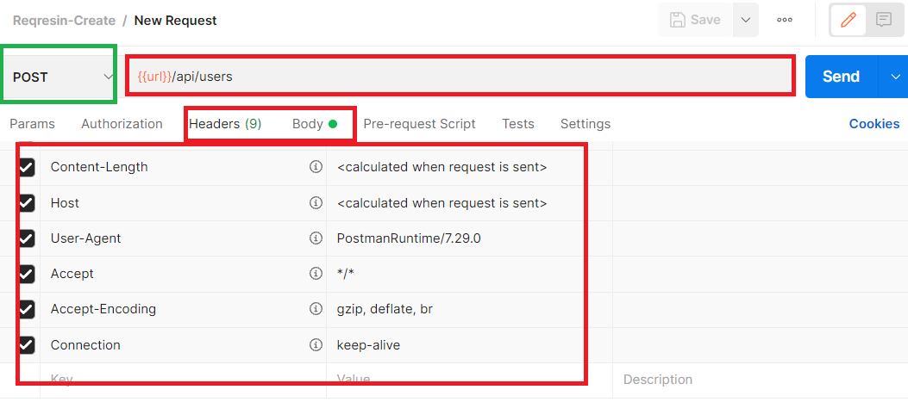
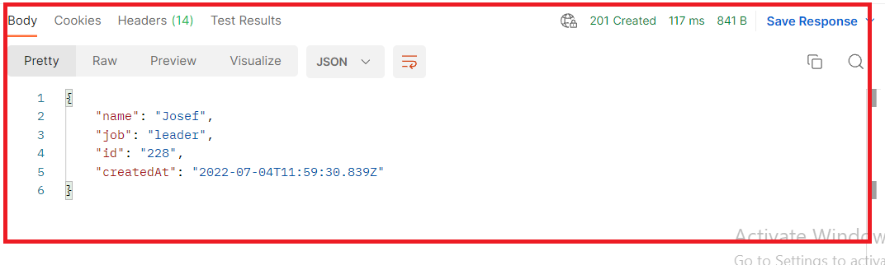
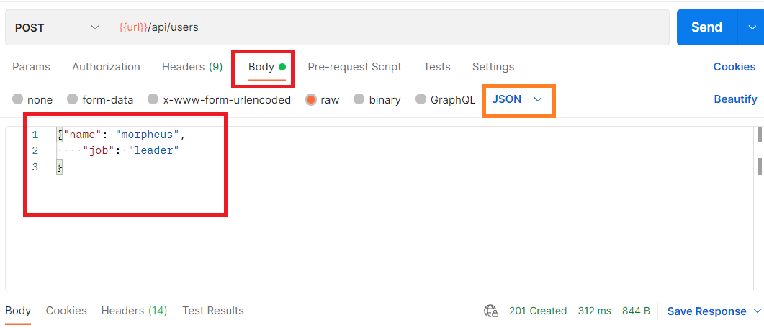
Create User – POST Method
- Request - Response

Slide 8
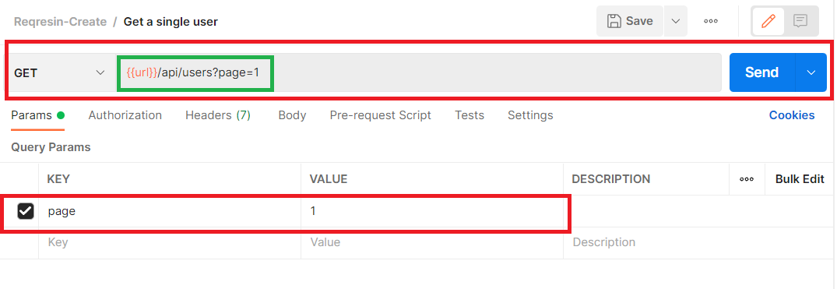
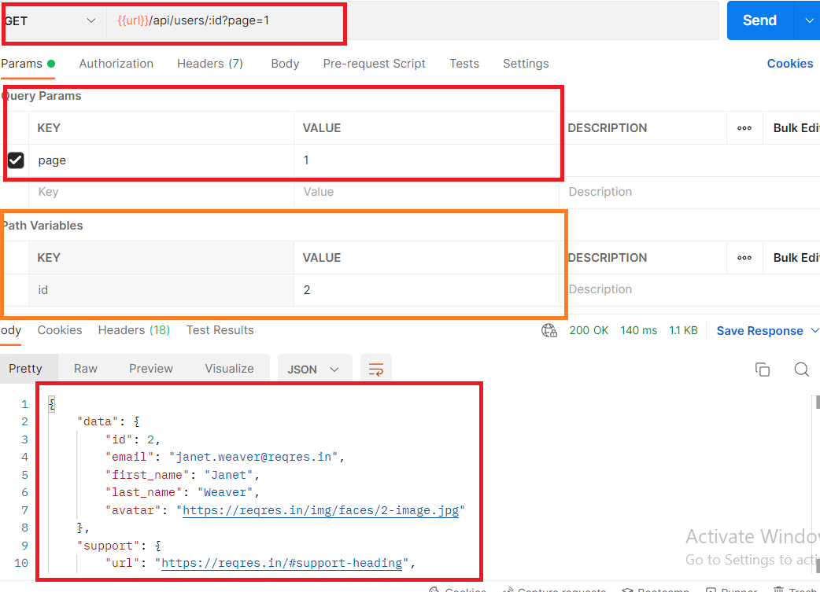
Get All Users Query & Path Parameters
- Get All Users on Page (1) - Get User num 2 in Page (1
{{url}}/api/users?page=1 {{url}}/api/users/:id?page=2

Slide 9
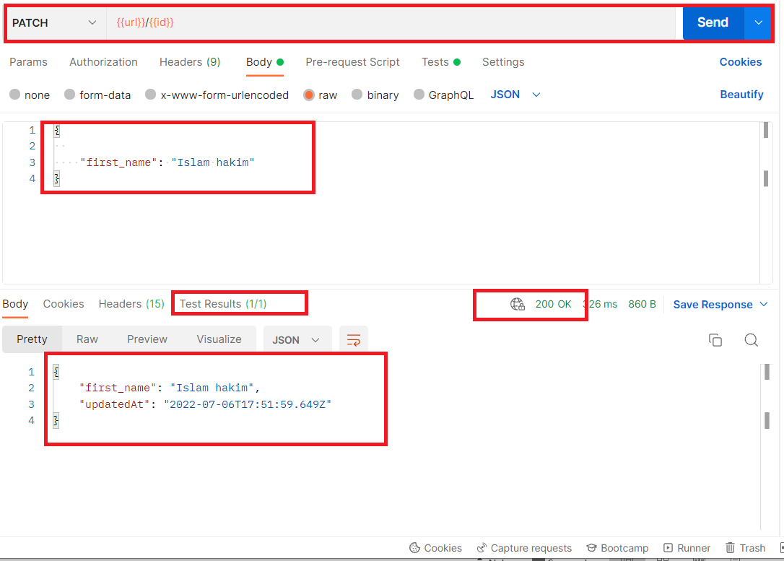
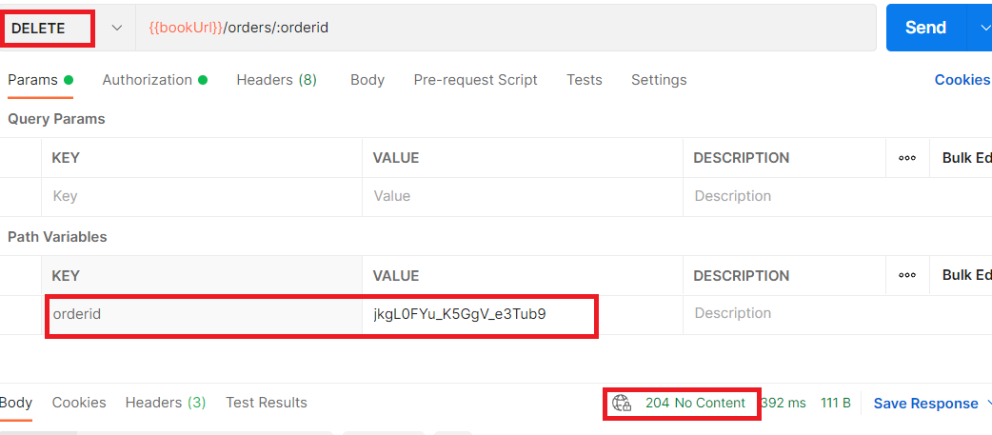
PATCH – Delete Methods

Slide 10
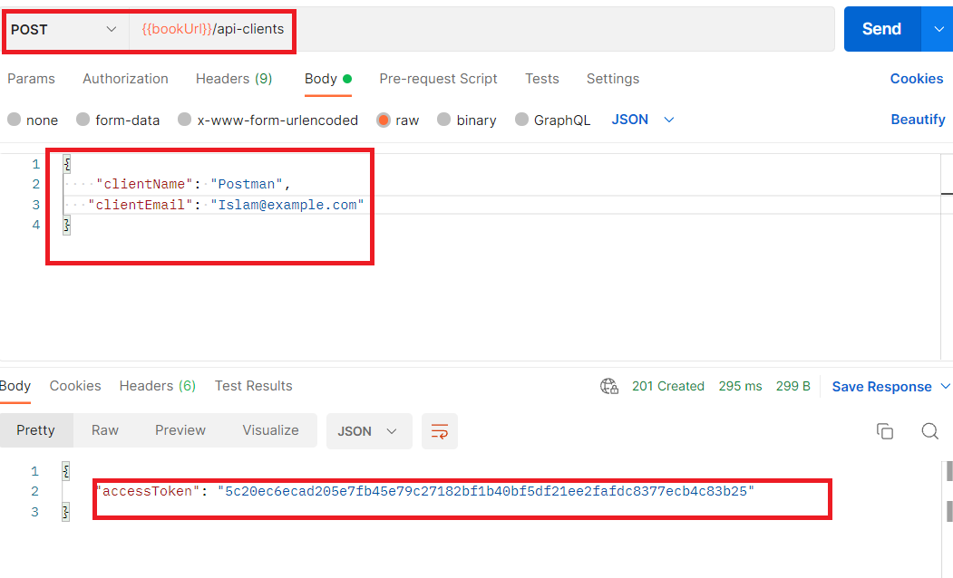
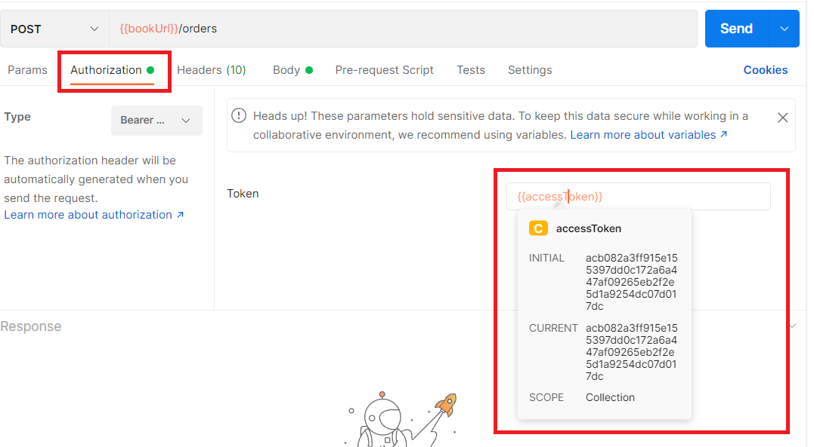
POST / API Authentication
Sometimes The endpoint for submitting users/orders requires authentication.

Slide 11
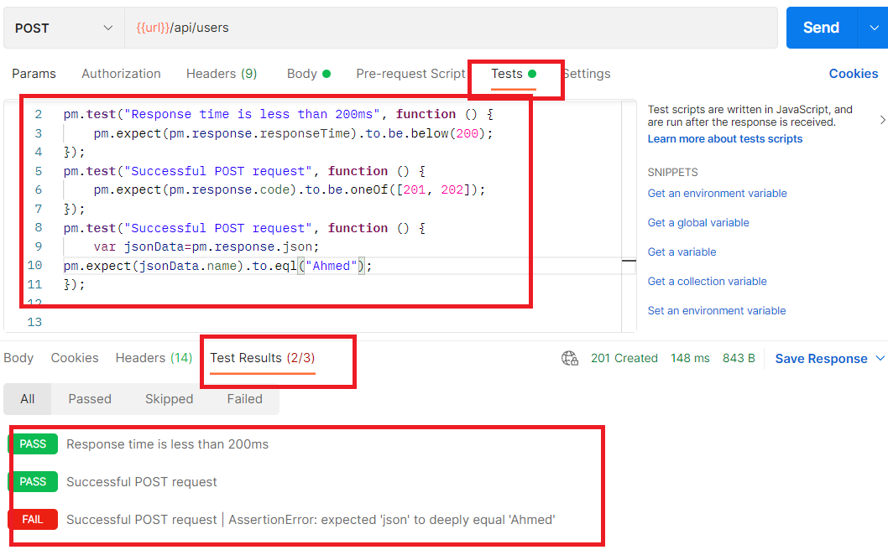
API Tests
We are looking at the response to understand if the API is working properly.

Slide 12
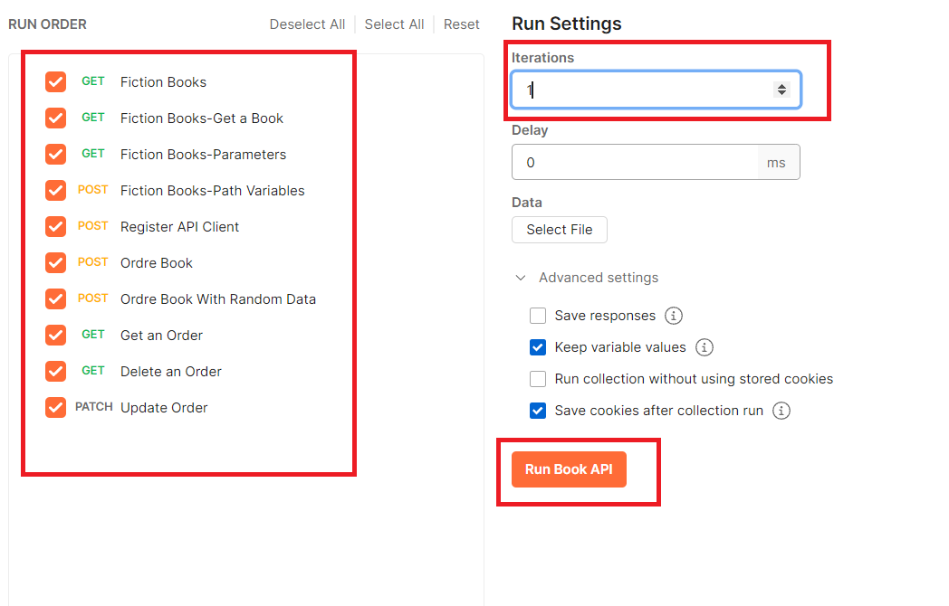
Collections
The Collection runner allows you to execute the entire collection with just one click.

Slide 13
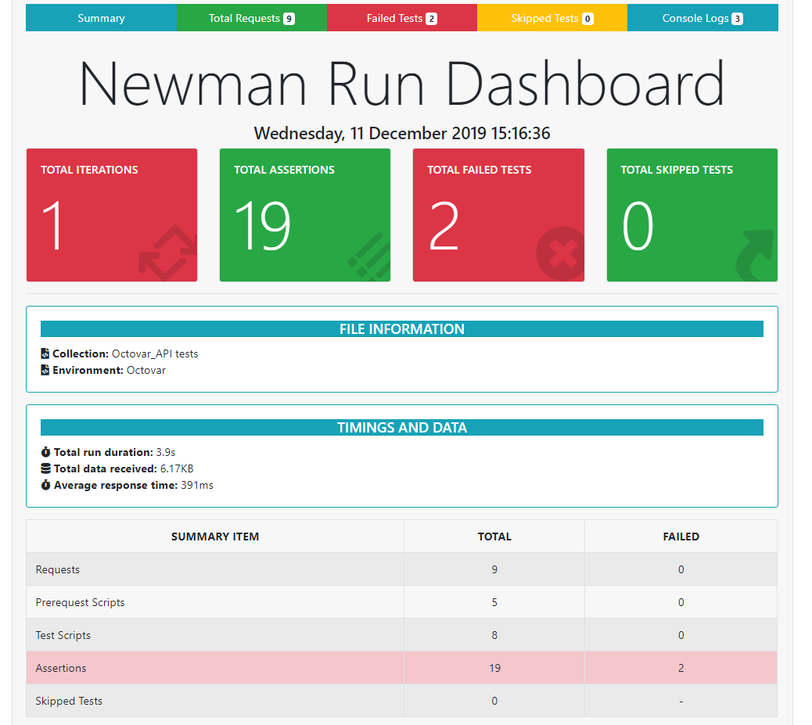
Newman-HTML Reports
newman run collection.json -r htmlextra
Newman is a command-line runner for Postman collections, it allows a user to run an existing Postman collection through the command line.
First: install Newman https://www.npmjs.com/package/newman
Import The Collection.
On CMD Go To Collection Location.
Run “Newman run testCollection.json”
IF you want To Generate Report Using Newman:
First: Run “npm install –g newman-Reporter-htmlextra”
Newman run collection.json –r htmlextra
Notes:
Uniform distribution symmetric

Slide 14
Practical Example
Testing Create User API
Testing Unsuccessful Register API
We will Use Postman To Check The Functionality, Performance, And Security Of [Create User-Unsuccessful Register] APIs.
--- Launch Postman ---

